Slide 1
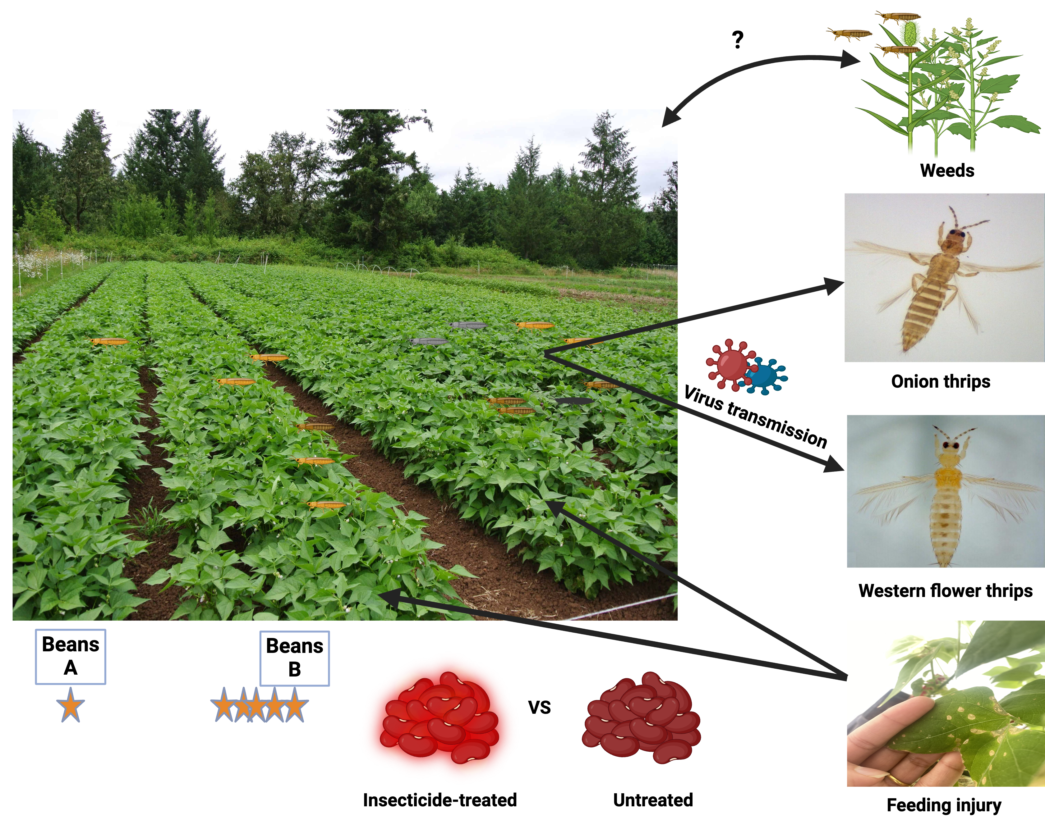
Thrips: Tiny Terrors or Misunderstood Miniatures?

